Slide 1
Fire Detection System using Arduino & Flame Sensor
Group 1:
Tanushree B S 20191COM0241 – Team Lead
Ronit Reddy 20191COM0115
Iril Veneza 20191COM0076
Disha B 20191COM0052
Keerthana P 20191COM0099

Slide 2
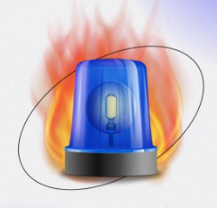
INTRODUCTION
Fire Alarm Systems are very common in commercial building and factories, these devices usually contain a cluster of sensors that constantly monitors for any flame, gas, or fire in the building and triggers an alarm if it detects any of these.
Now, in the event of a fire, the fire will not only produce heat but will also emit IR rays, yes every burning flame will emit some level of IR light, this light is not visible to human eyes but our flame sensor can detect it and alert a microcontroller like Arduino that a fire has been detected.
One of the simplest ways to detect fire is by using an IR Flame sensor, these sensors have an IR photodiode that is sensitive to IR light.

Slide 3
TABLE OF CONTENTS
PROBLEM STATEMENT
ARCHITECTURE
SIMULATION
OUTCOME

Slide 4
01
PROBLEM STATEMENT

Slide 5

Why are fire detection and alarm systems required?
To detect fire in the areas.
Notify building occupants to take evasive action to escape the dangers of hostile fire.
Summon organized assistance to initiate or assist in fire control activities.
Initiate automatic fire control & suppression systems & to sound alarm.
Supervise fire control & suppression systems to assure operational status is maintained Initiate auxiliary functions involving environmental, utility & process controls

Slide 6
02
ARCHITECTURE

Slide 7
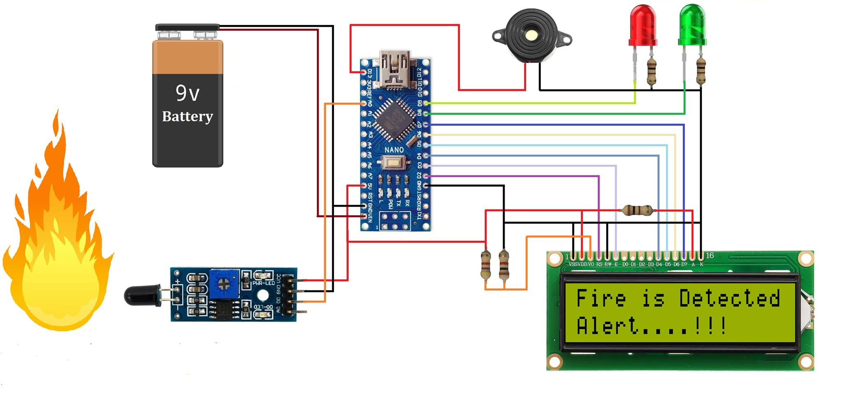
Red &
Green
LED’S
5V
Buzzer
Resistor
16 x 2 LCD
Display
9V Battery
Arduino Nano
Flame sensor

Slide 8
COMPONENTS
USED

Slide 9
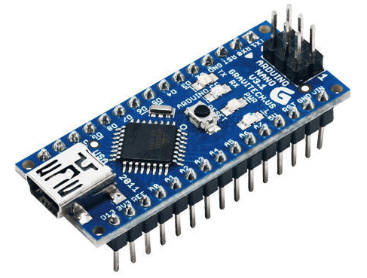

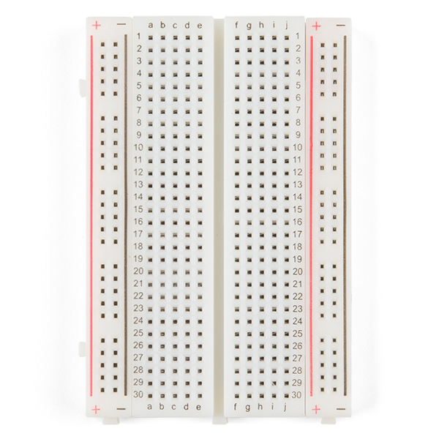
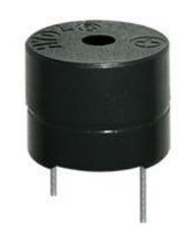
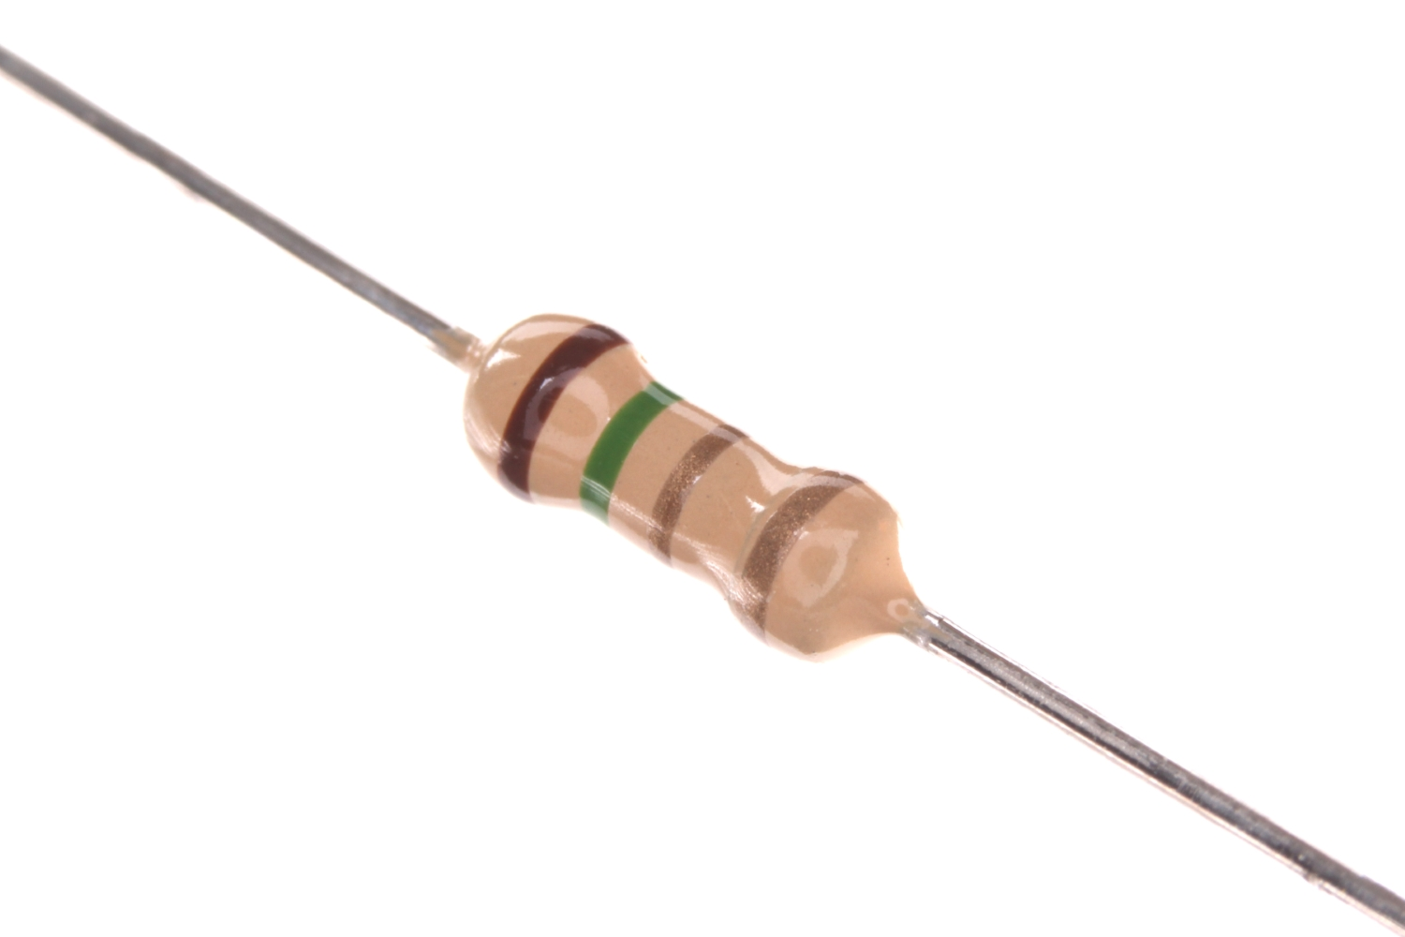
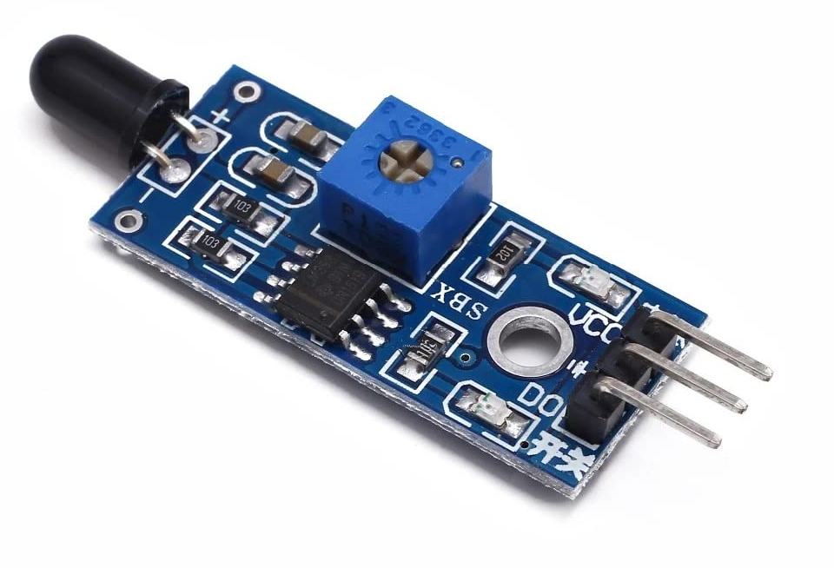
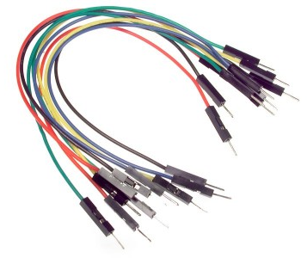
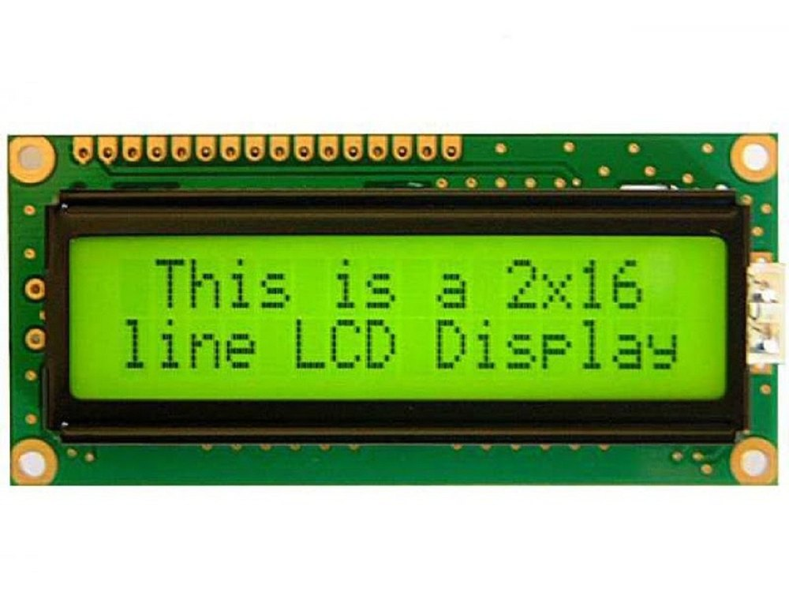
1
2
Arduino Nano
LED Lights – Red & Green
Breadboard
5V Buzzer
Flame sensor
Jump Wires
LCD Display – 16 x 2
Resistors
3
4
8
7
5
6

Slide 10




SYSTEM PREREQUISITE
Software used:
Arduino 1.8.1
Proteus 8 Professional
Personal Computer - Windows 10
C programming

Slide 11
03
SIMULATION

Slide 12
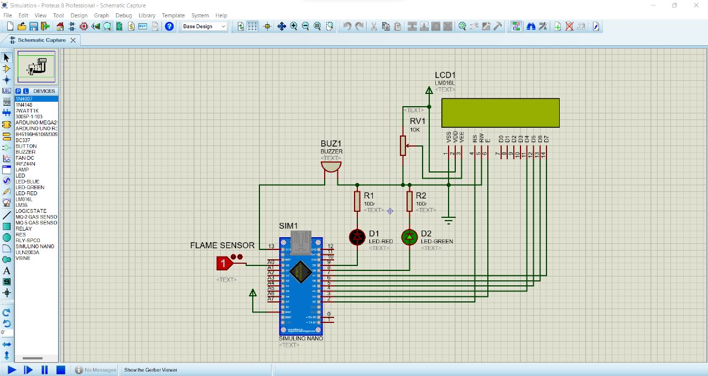
Proteus 8 Professional
Software

Slide 13
04
OUTCOME

Slide 14
Gives us a signal by glowing led and buzzer sound when flame is produced.
Also, gives us a display on LCD screen when flame is produced.
Ensure the safety of the machine.
Necessary steps can be taken to prevent the consequences.
Increase the lifetime

Slide 15
THANK YOU

